Slide 1
Database Performance Optimization
COMP / IT 420 Spring 2021
April 26th, 2021

Slide 2
Updates and Reminders
Presentations are on Weds, May 12th in lab session
Slides are due Tues, May 11th at 11:59pm
Lab this week is the last mandatory graded lab.
Next week will be lab and homework review.
Final review session is Monday, May 10th during lecture period
Lecture next week is on admin and security, with further SQL review.

Slide 3
Updates and Reminders
Final database project reminder that most of the points are for implementing MySQL objects (procedures, triggers, views) at 40%
GUI implementation is 10% of project grade

Slide 4
Updates and Reminders
Presentation requirements are now posted, and as follows:
Who are you?
How does your database solve a particular problem for a specific domain?
What is the problem?
Why is it a problem?
What is your solution?
Why is it a solution?
How does your application work?
What are the features?
How does the user interact with it?
How is your application and database implemented?
What technologies did you use?
Explain, briefly, the database schema and ERD diagram.
What advanced views, triggers and queries are possible in your implementation?

Slide 5
Updates and Reminders
Presentations must be in Powerpoint (.pptx) format.
The grading for the presentation will be done by your peers in the class. I will post a grading quiz on Canvas for you to fill out while we are presenting. If you are not present for your group presentation, you will not get credit for it. As a result, you will be required to share your video while presenting.
The rubric has five categories on a five-point (1-low, 5-high) scale:
Objective: The DB and application solve a business need or problem
Design: The DB design was correct and complete.
Interest: The DB and application was creative and / or interesting.
Complexity: The DB was of suitable complexity. (12 or more entities with 3 or more attributes each.)
Presentation: The presentation communicated the DB and application design and intent successfully.
You will need to include diagrams, UI mock-ups and workflows, etc. To get full credit, presentations consisting of basic text only will not receive full credit.

Slide 6
Learning Objectives
Performance Tuning Concepts
Database Internals (briefly)
Query Optimization
Indexing
Querying the Data Dictionary

Slide 7
What is Database Performance?
Database performance is basically executing queries more quickly
Database performance tuning
Set of activities and procedures that reduce response time of database system
DB tuning requires all aspects operate at optimum level with minimal bottlenecks
Essentially focused on reducing the need to go to disk and use I/O.

Slide 8
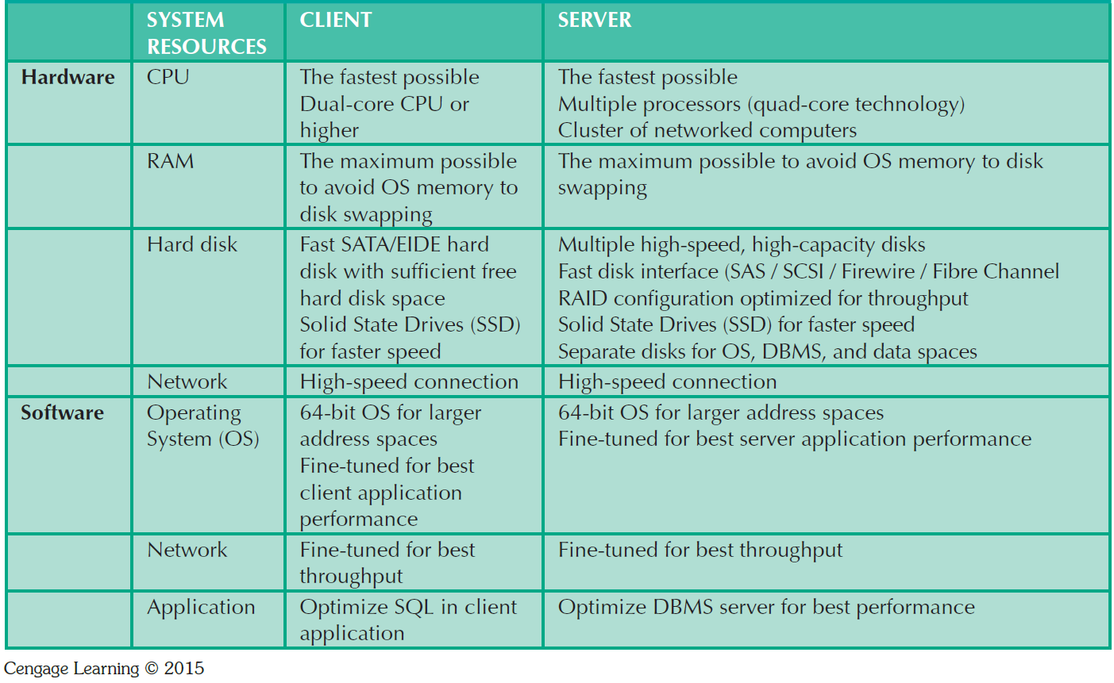
General Guidelines for Better System Performance
Fast
|
|
|
|
|
V
Slow

Slide 9

Performance Tuning: Client and Server
SQL performance tuning
Queries are responsive and require minimum resources
Client-side optimization
Client software optimization
DBMS performance tuning
DBMS environment optimized
cache, I/O, locking, replication, backup
Server side optimization
DB implementation optimization

Slide 10
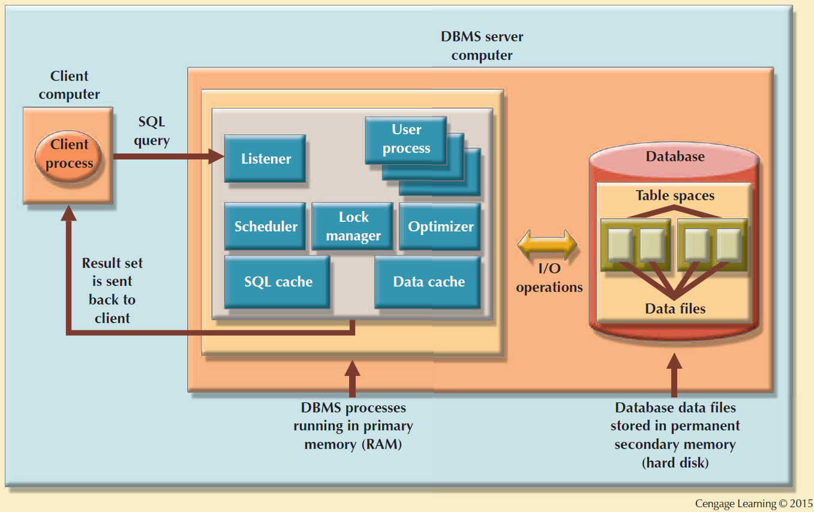
Basic DBMS Architecture

Slide 11
DBMS Architecture
DB data is stored in data files
Data files expand in increments known as extents
Data files are grouped in tablespaces
Tablespace: Logical grouping of several data files that store data with similar characteristics
Data cache: Shared, reserved memory area
Stores most recently accessed data blocks in RAM

Slide 12
Volatile (Memory) vs. Non-Volatile (Disk)
Memory
Disk (Storage)
DBMS Query
Process

Slide 13
Volatile (Memory) vs. Non-Volatile (Disk)
Memory
Disk (Storage)
DBMS Query
Process
}
Database
File(s)
Buffer Pool
Pages or Blocks
MySQL (16K) default

Slide 14
Volatile (Memory) vs. Non-Volatile (Disk)
Memory
Disk (Storage)
DBMS Query
Process

Slide 15
Volatile (Memory) vs. Non-Volatile (Disk)
Memory
Disk (Storage)
DBMS Query
Process
1
1

Slide 16
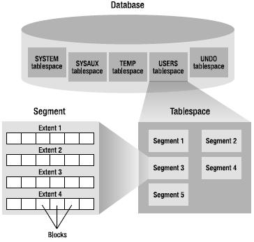

Slide 17
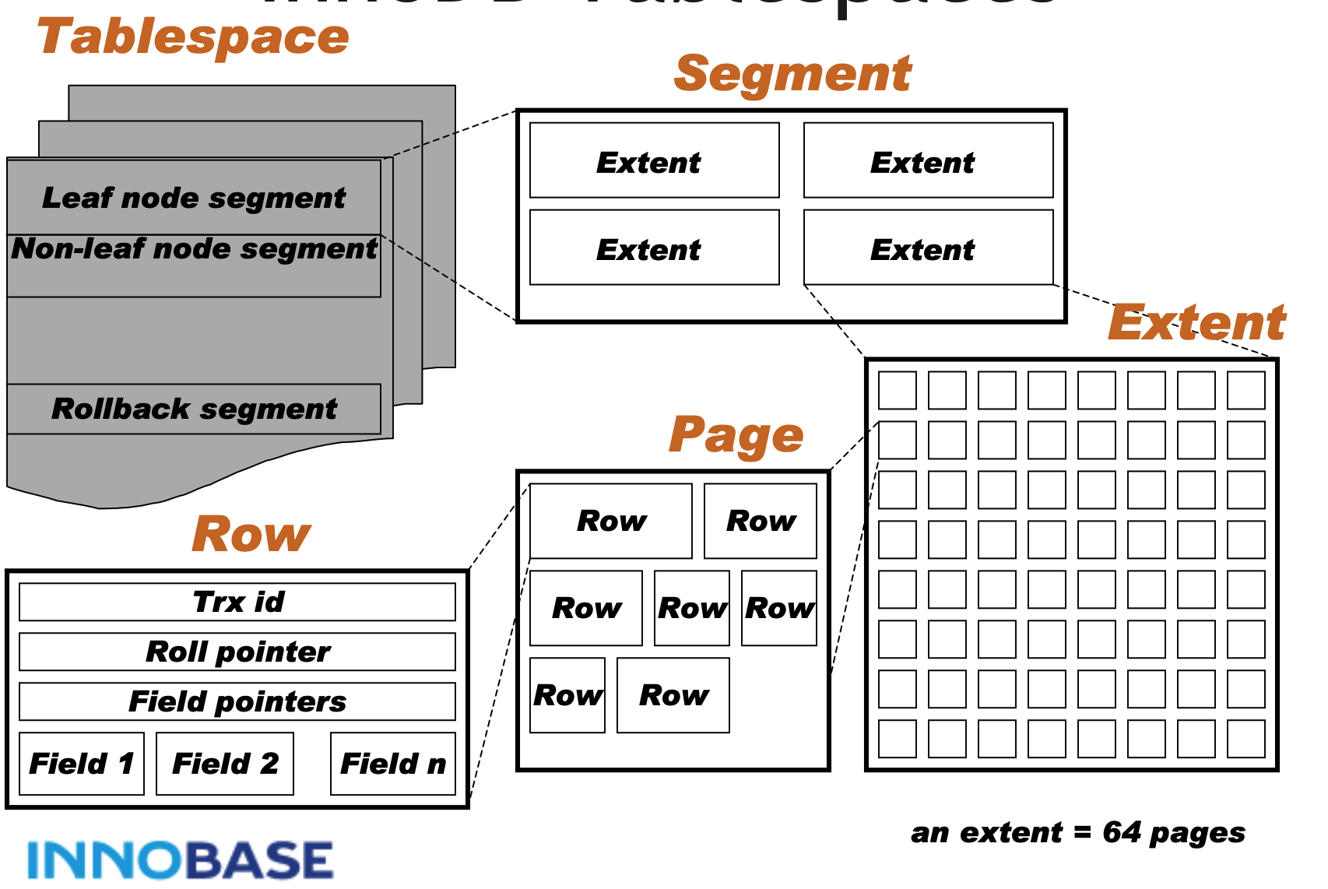

Slide 18
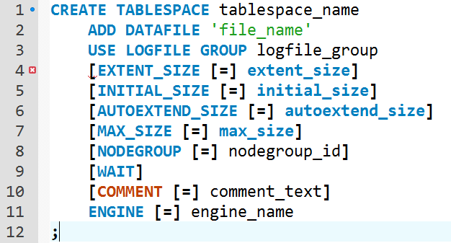

Slide 19
DBMS Architecture
A SQL cache stores most recently executed SQL statements or PL/SQL procedures
DBMS retrieves data from permanent storage and places them in RAM (data cache)
Input/output (I/O) request: Low-level data access operation that reads or writes data to and from computer devices

Slide 20
DBMS Architecture
Cache is always faster than working with disk
Majority of performance-tuning activities focus on minimizing I/O operations

Slide 21
Basic DBMS Architecture

Slide 22
Database Query Optimization
Algorithms for query optimization are based on determining
query execution order and
data location / communication.
Automatic query optimization: DBMS finds the most cost-effective access path without user intervention
Manual query optimization: Requires that the optimization be selected and scheduled by the end user or programmer

Slide 23
Classification Based on Timing of Optimization
Static query optimization: best optimization strategy is selected when the query is compiled by the DBMS
Takes place at compilation time
Dynamic query optimization: Access strategy is dynamically determined by the DBMS at run time, using the most up-to-date information about the database
Takes place at execution time

Slide 24
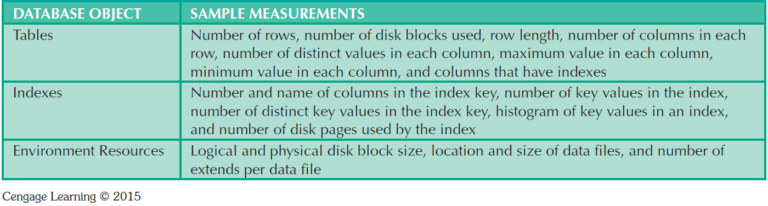
Sample Database Statistics Measurements

Slide 25
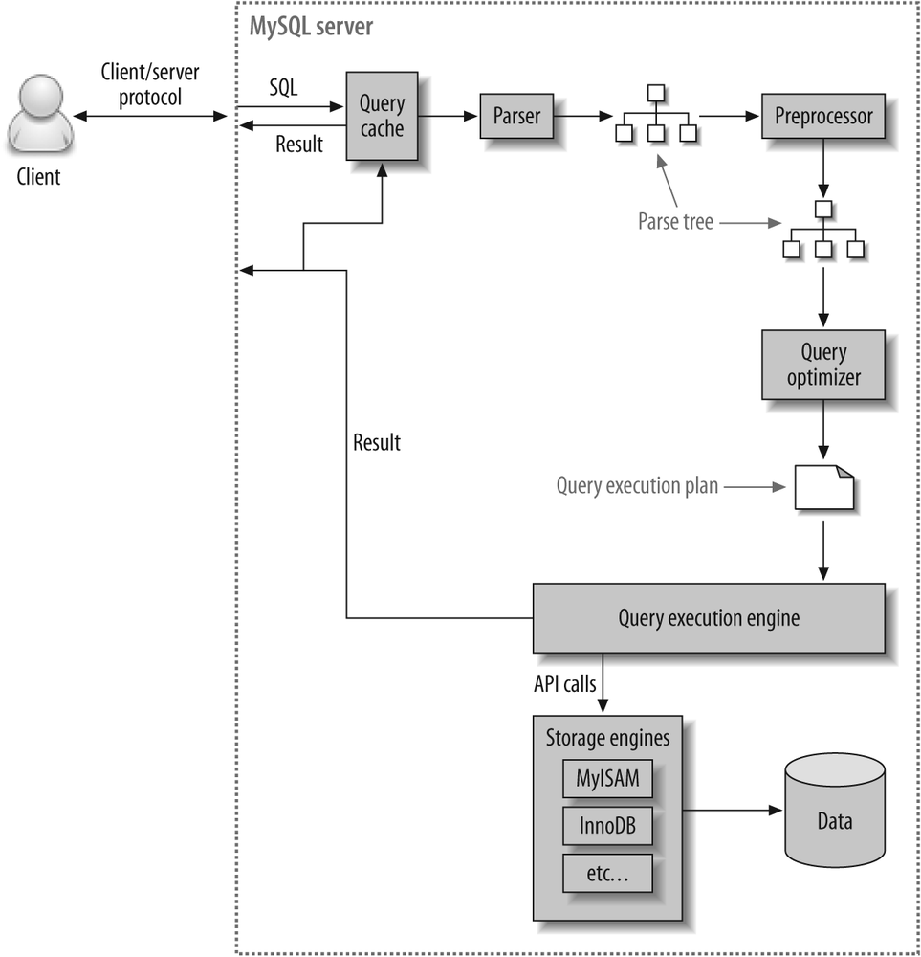
Query Processing (MySQL)
DBMS parses the SQL query and chooses the most efficient access/execution plan
DBMS executes the SQL query using the chosen execution plan
DBMS fetches the data and sends the result set back to the client

Slide 26
SQL Parsing Phase
Divide and Conquer
Query is broken down into smaller units
For efficiency, the original SQL query is transformed into slightly different version of the original SQL code
Query optimizer
Analyzes query to find most efficient way to access data

Slide 27
SQL Parsing Phase
Access plans
Are DBMS-specific and translate client’s SQL query into a series of complex I/O operations
If access plan exists (cached), it is reused. If not, the optimizer chooses and caches new one.

Slide 28
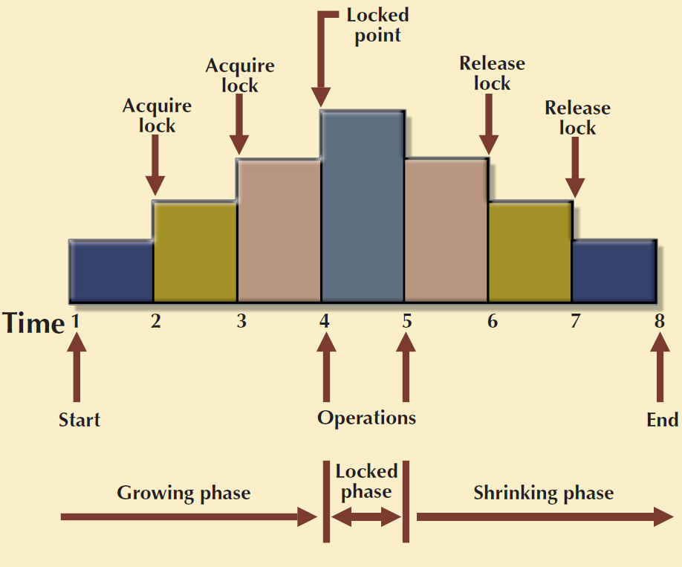
SQL Execution Phase
All I/O operations indicated in the access plan are executed
Locks are acquired
Data are retrieved and placed in data cache
Transaction management commands are processed

Slide 29
SQL Fetching Phase
Rows of resulting query result set are returned to client
DBMS may use temporary table space to store temporary data
DBMS coordinates the movement of the result set rows from the server cache to the client cache

Slide 30
Query Processing Bottlenecks
Delay introduced in the processing of an I/O operation that slows the system
Caused by the:
CPU
RAM
Hard disk
Network
Application code

Slide 31
I/O Access Strategies
Table Scan
Reads entire table sequentially, from first to last row
Table Access
Reads row directly based on provide row ID value
Index Scan
Reads index first to obtain row IDs

Slide 32
Indexes and Query Optimization
Indexes
Ordered set of values that contain the index key and pointers
Help speed up data access
Facilitate searching, sorting, using aggregate functions, and join operations
More efficient than a full table scan

Slide 33
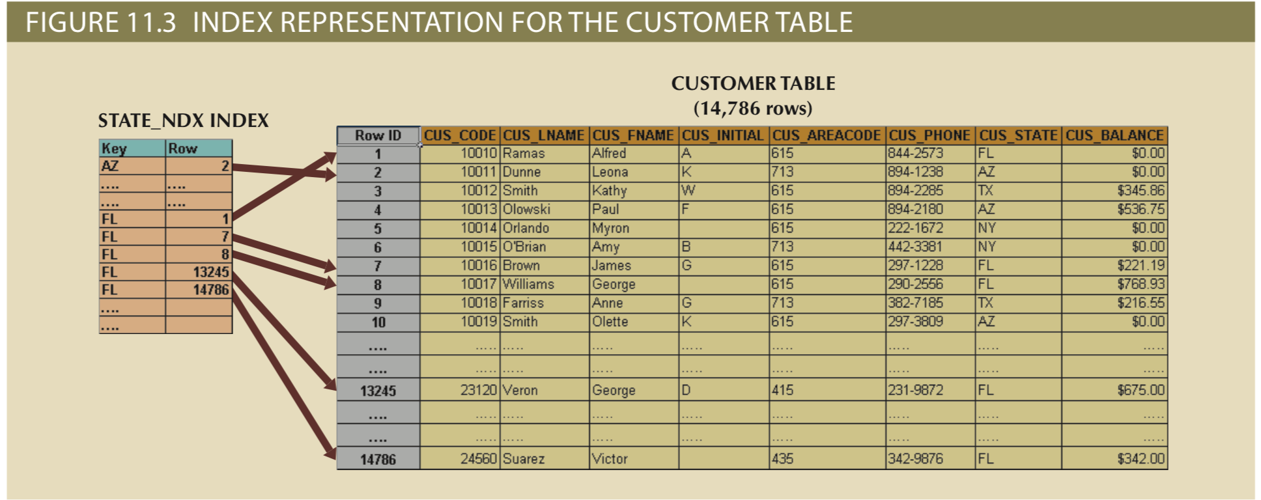
SELECT cus_name, cus_state
FROM customer
WHERE cus_state = “FL”
How many I/O reads if there is not an index on CUS_STATE?
How many I/O reads if there is an index on CUS_STATE?

Slide 34
Indexes and Query Optimization
Data sparsity refers to the number of possible values for a given field
Data structures used to implement indexes:
Hash indexes
B-tree indexes
Bitmap indexes
DBMSs determine best type of index to use

Slide 35
Index Data Structures
Hash indexes are based on a ordered-list of hash values good for equality conditions
B-tree or B+-tree (balanced) are an ordered tree data structure organized by pointers to row data
Bitmap indexes are a collection of bit-arrays denoting the existence of a field value

Slide 36
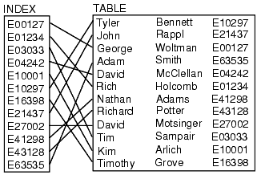
Index Example
select * from table where id=‘E21437’
Search Index for E21437
Retrieve pointer to table
Retrieve data

Slide 37
B-tree Data Structure
Self-balancing tree that keeps data sorted and allows searches, sequential access, insertions, and deletions in logarithmic time.
The B-tree is a generalization of a binary search tree in that a node can have more than two children (Comer 1979).

Slide 38
B-tree Data Structure
MySQL uses B+ trees where each leaf links to another in a manner that all leafs connect.
B+ trees store all data in leaf nodes only
MongoDB uses B-trees as its underlying JSON data structure is already a tree
O(log n) search, insert and delete

Slide 39
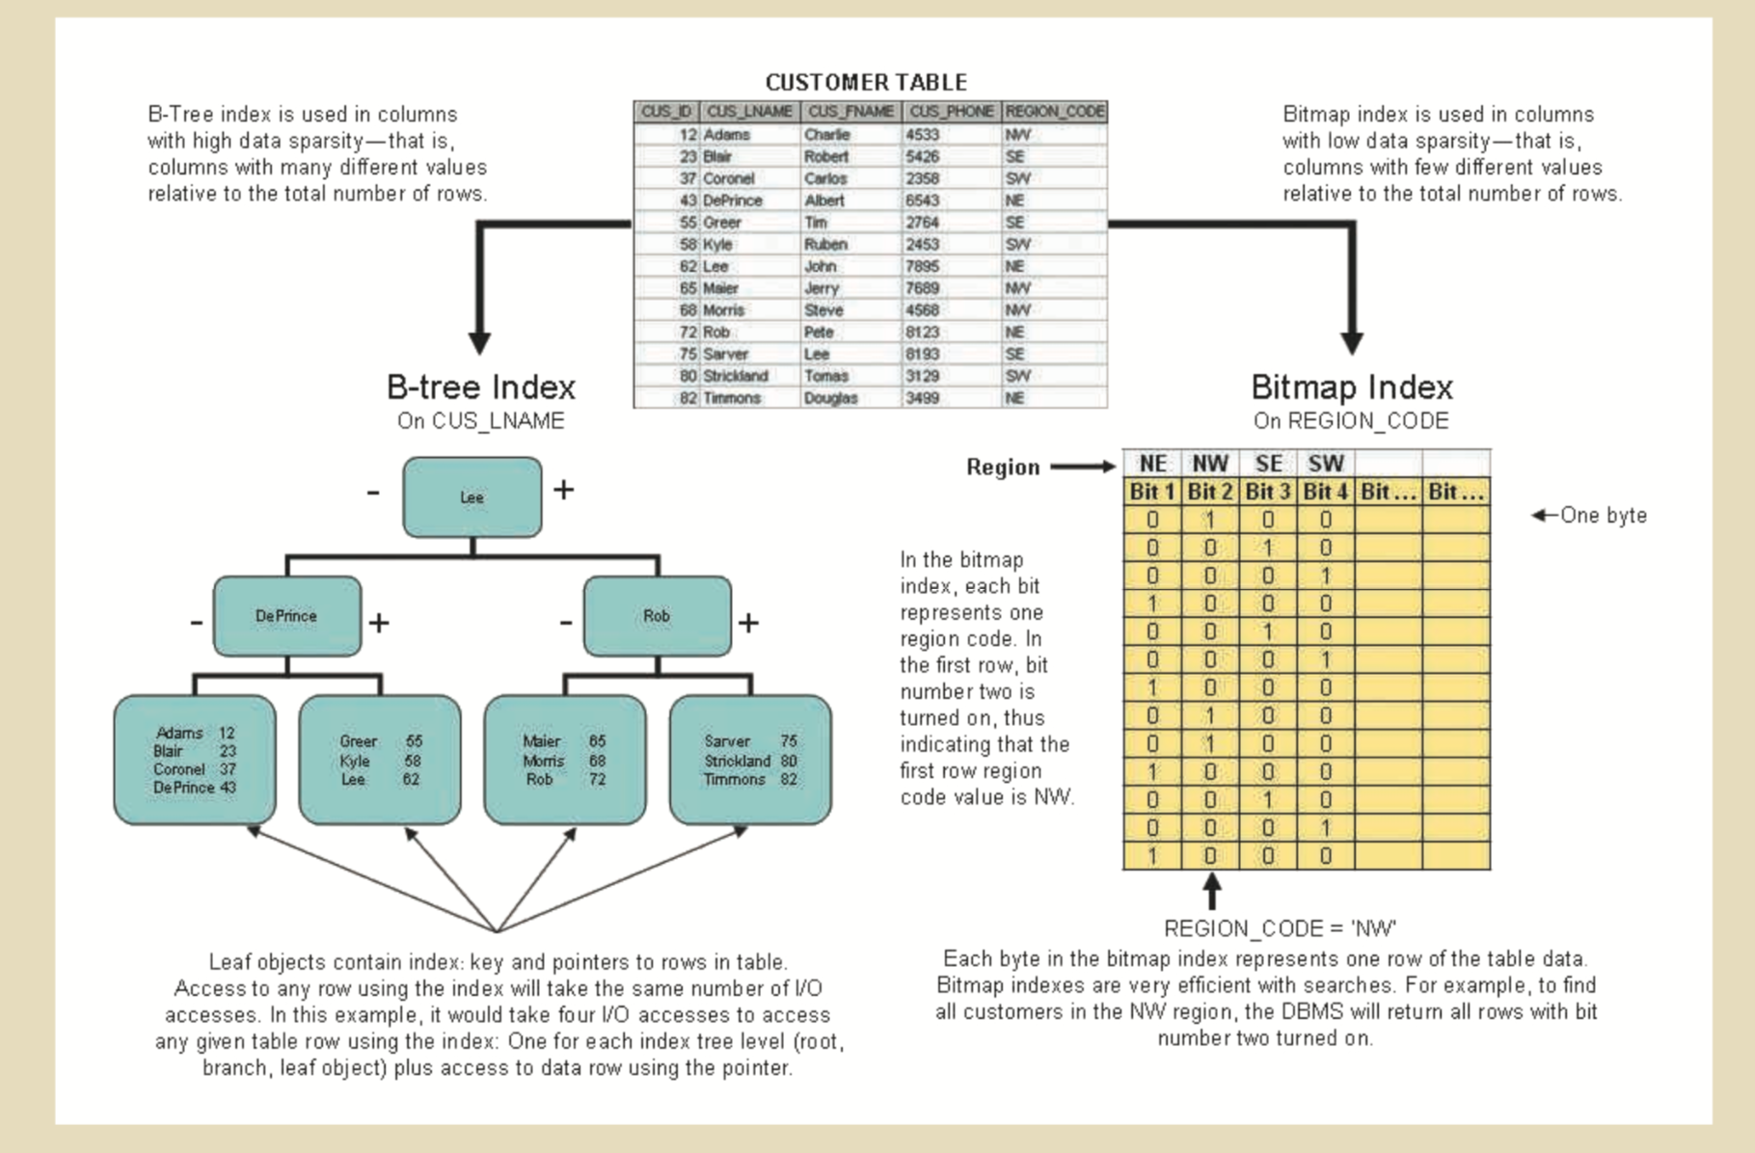

Slide 40
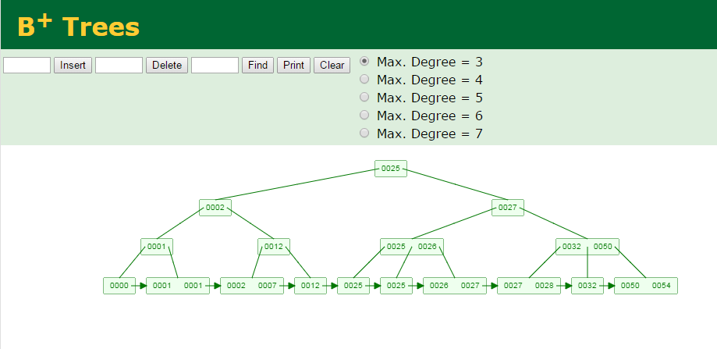
B+ Tree Example
https://www.cs.usfca.edu/~galles/visualization/BPlusTree.html

Slide 42
DB Indexes
Indexes find rows with specific column values.
Without an index, a database begins with the first row and reads through the entire table.
The larger the table, the more this costs.
Indexes quickly determines the position to seek to in the middle of the data file without having to look at all the data.
If a table has 1,000 rows, this is at least 100 times faster than reading sequentially.

Slide 43
Index Selectivity
Measure of the likelihood that an index will be used in query processing
Indexes are used when a subset of rows from a large table is to be selected based on a given condition
Index cannot always be used to improve performance

Slide 44
Index Data Structure (MySQL)
PRIMARY KEY, UNIQUE, INDEX, and FULLTEXT are stored in B+-trees by default in InnoDB.
Find rows matching a WHERE clause quickly.
Eliminate rows from consideration.
Retrieves rows from other tables when performing joins.
MySQL can use indexes on columns more efficiently if they are declared as the same type and size.

Slide 45
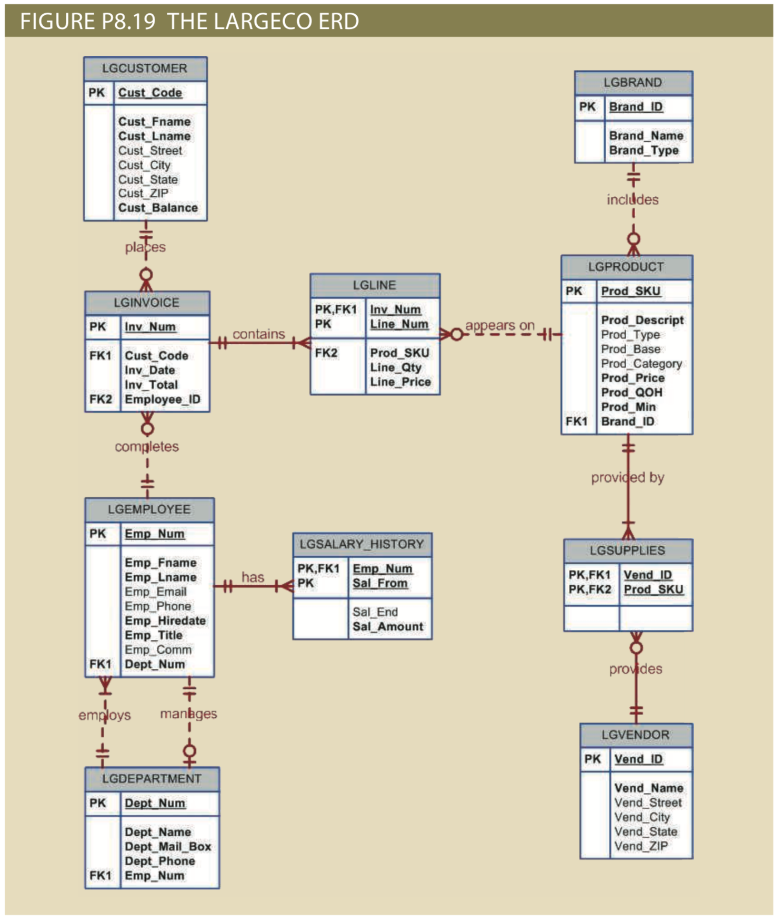

Slide 46
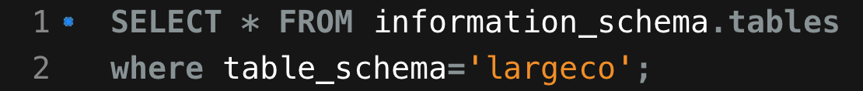
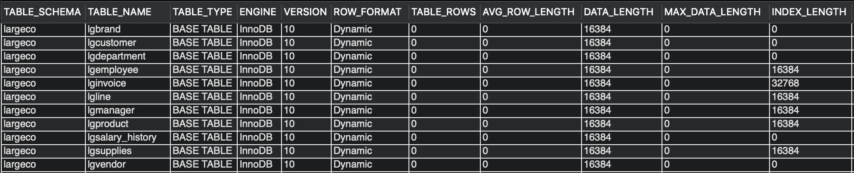
Insert a bunch of data and …

Slide 47
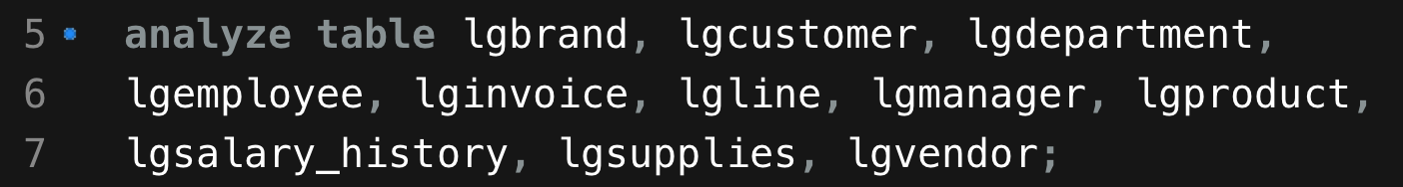
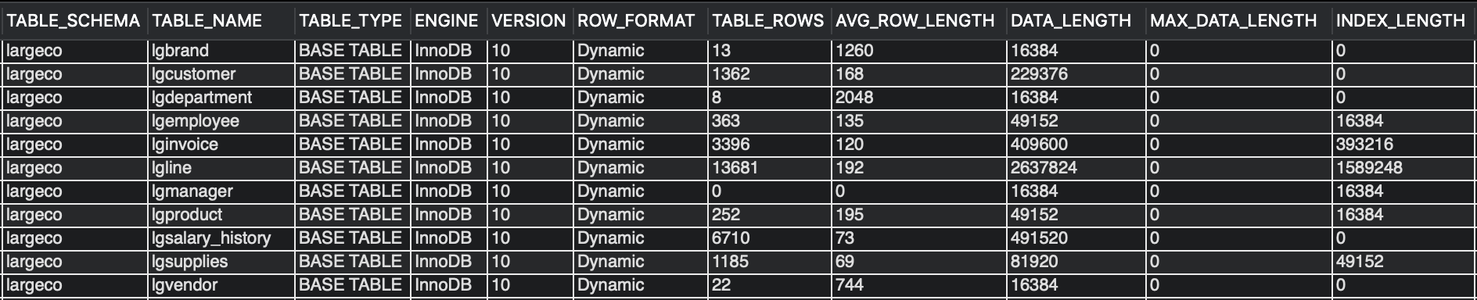

Slide 48
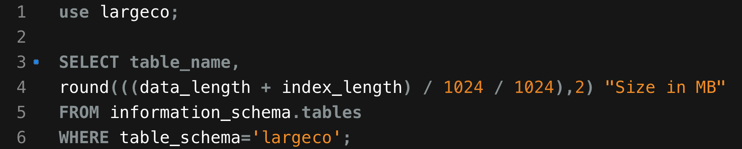
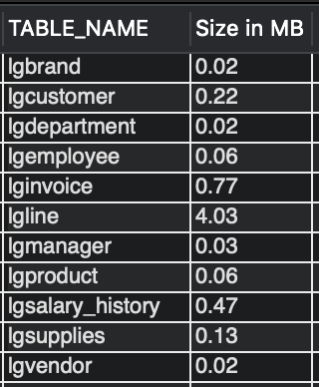

Slide 49
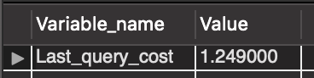
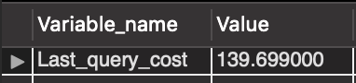
SALECO v. LARGECO
10
1362

Slide 50
SALECO v. LARGECO
Optimizer estimates are based on:
Number of pages per table or index,
Cardinality (number of distinct values) of indexes
Length of rows and keys, and key distribution.
Does not consider caching and assumes every read will result in a disk I/O operation.
Optimizer estimates it would need _____ random data page reads to select customers from saleco versus _____ random data page reads to select customers from largeco.

Slide 51
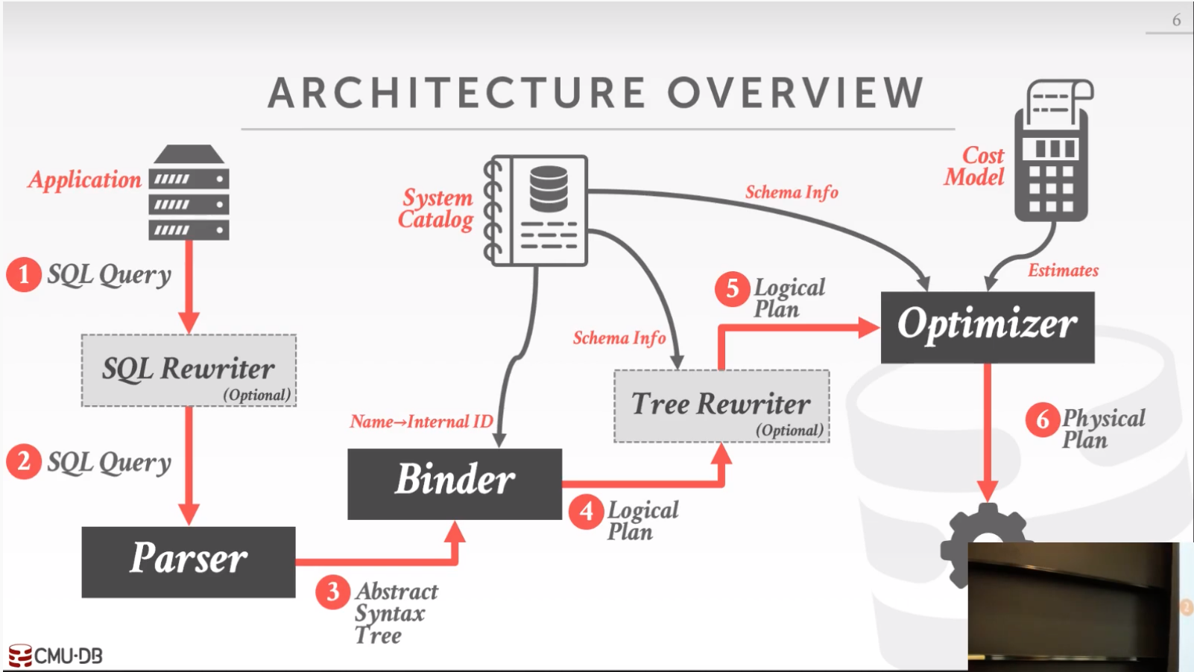
https://www.youtube.com/watch?v=28hSVkOs6x8

Slide 52
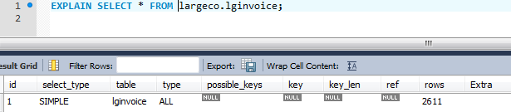
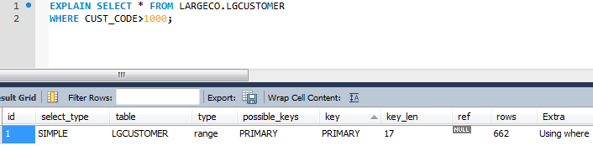
EXPLAIN
Why is the key_len 17 bytes?

Slide 53

SQL Performance Tuning
Most current RDBMSs perform automatic query optimization at the server end
Most SQL performance optimization techniques are DBMS-specific and are rarely portable
Majority of performance problems are related to poorly written SQL code and lack of proper indexing (i.e. poor DB design)

Slide 54
Simple Plan Optimization
SELECT P_CODE, P_DESCRIPT, V_STATE
FROM PRODUCT P, VENDOR V
WHERE P.V_CODE = V.V_CODE
AND V.V_STATE = “FL”;
The PRODUCT table has 7,000 rows.
The VENDOR table has 300 rows.
Ten vendors are located in Florida.
One thousand products come from vendors in Florida.

Slide 55
Simple Plan Optimization
SELECT P_CODE, P_DESCRIPT, V_STATE
FROM PRODUCT P, VENDOR V
WHERE P.V_CODE = V.V_CODE
AND V.V_STATE = “FL”;
The PRODUCT table has 7,000 rows.
The VENDOR table has 300 rows.
Ten vendors are located in Florida.
One thousand products come from vendors in Florida.

Slide 56
Simple Plan Optimization
SELECT P_CODE, P_DESCRIPT, V_STATE
FROM PRODUCT P, VENDOR V
WHERE P.V_CODE = V.V_CODE
AND V.V_STATE = “FL”;
The PRODUCT table has 7,000 rows.
The VENDOR table has 300 rows.
Ten vendors are located in Florida.
One thousand products come from vendors in Florida.

Slide 57
Simple Plan Optimization
SELECT P_CODE, P_DESCRIPT, V_STATE
FROM PRODUCT P, VENDOR V
WHERE P.V_CODE = V.V_CODE
AND V.V_STATE = “FL”;
The PRODUCT table has 7,000 rows.
The VENDOR table has 300 rows.
Ten vendors are located in Florida.
One thousand products come from vendors in Florida.

Slide 58
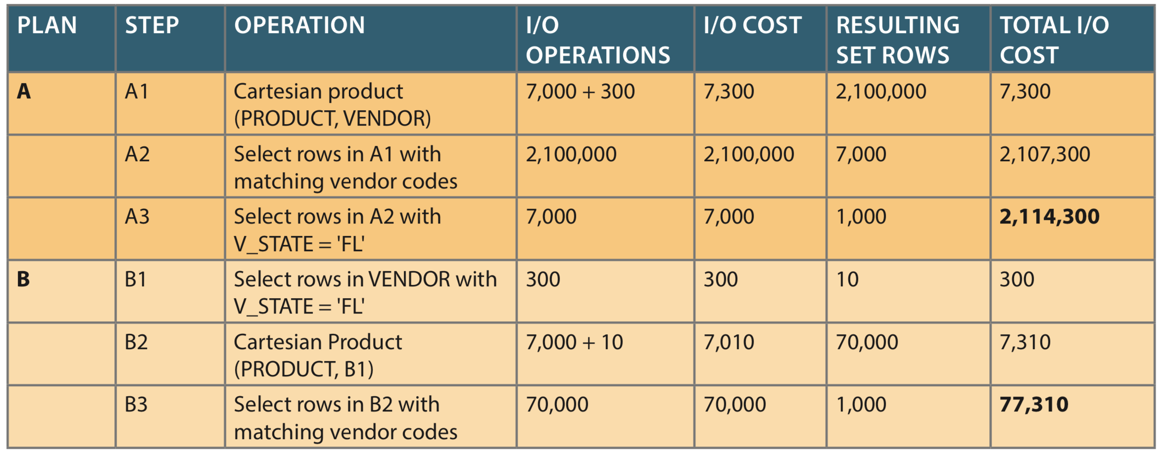

Slide 59
Conditional Expressions
Expressed within WHERE or HAVING clauses of a SQL statement
Restricts the output of a query to only rows matching conditional criteria
Guidelines to write efficient conditional expressions in SQL code
Use simple columns or literals as operands
Numeric field comparisons are faster than character, date, and NULL comparisons

Slide 60
Conditional Expression
Equality comparisons are faster than inequality comparisons
Transform conditional expressions to use literals
Write equality conditions first when using multiple conditional expressions
When using multiple AND conditions, write the condition most likely to be false first
When using multiple OR conditions, put the condition most likely to be true first
Avoid the use of NOT logical operator

Slide 61
DBMS Performance Tuning
DBMS performance tuning at server end
focuses on setting parameters used for:
Data cache
SQL cache
Sort cache
Optimizer mode
Partition tables based on usage
Use denormalized tables where appropriate
Store computed and aggregate attributes in tables

Slide 62
DBMS Performance Tuning
Recommendations for physical storage of databases:
Use RAID (Redundant Array of Independent Disks) to provide a balance between performance improvement and fault tolerance
Minimize disk contention
Put high-usage tables in their own table spaces
Assign separate data files in separate storage volumes for indexes, system, and high-usage tables

